Slide 1
Changing resolution in UPXO
- Dr. Sunil Anandatheertha

Slide 2
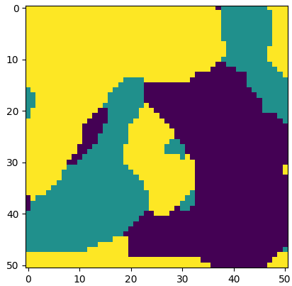
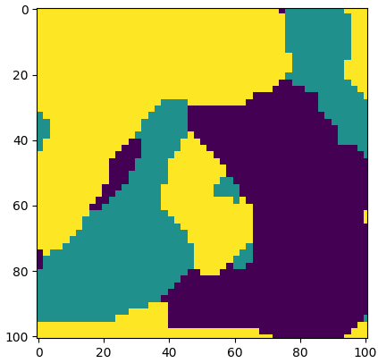
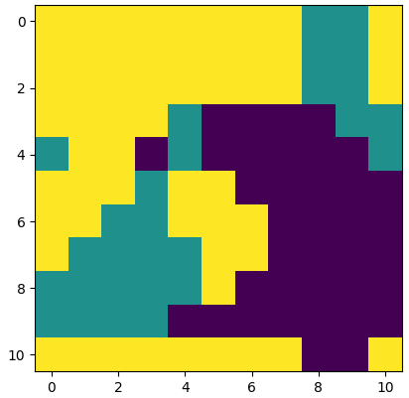



pxt.gs[8].plot()
ORIGINAL GS
FINE GS
COARSE GS
NOTE 1: Interpolation is achieved using "nearest" option in scipy.interpolate.RegularGridInterpolator()
NOTE 2: Dimensions in the image are on the image coordinates and not the spatial coordinates of the poly-crystal. Mapping is one-one between these coordinates.

